Slide 1
KUBE WATCH

Slide 2
What is kube watch
kubewatch is a Kubernetes watcher that publishes notifications
to Slack/hipchat/mattermost/flock channels. It watches the cluster
for resource changes and notifies them through web hooks.
Basically kubewatch looks for events like pod/deployment/confimap creation/deletion and sent notification to selected channels like
slack
hipchat
mattermost
flock
webhook
smtp

Slide 3
Kubewatch is an open-source Kubernetes tool that enables users to monitor and react to events that occur within a Kubernetes cluster. Kubewatch acts as a controller that listens to Kubernetes events and triggers configured actions based on those events.
Kubewatch is that it provides a powerful mechanism for automating and responding to changes within a Kubernetes environment. With Kubewatch, users can create custom event triggers that execute specific actions when events occur, such as sending notifications, scaling resources, or running scripts.

Slide 4
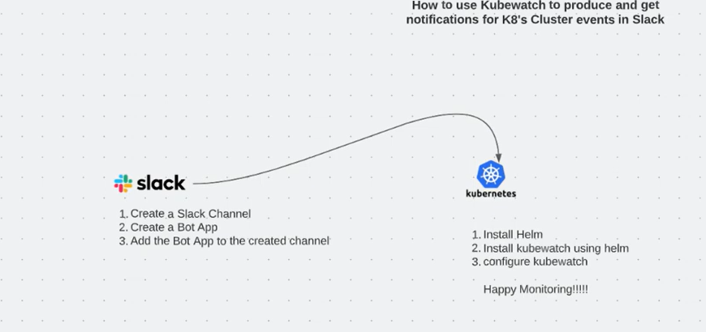

Slide 5
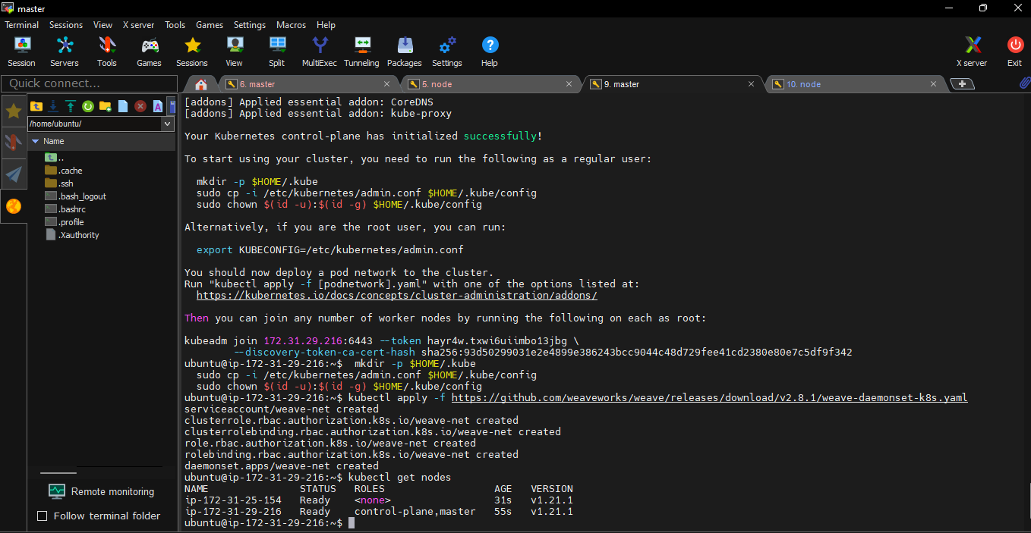

Slide 6
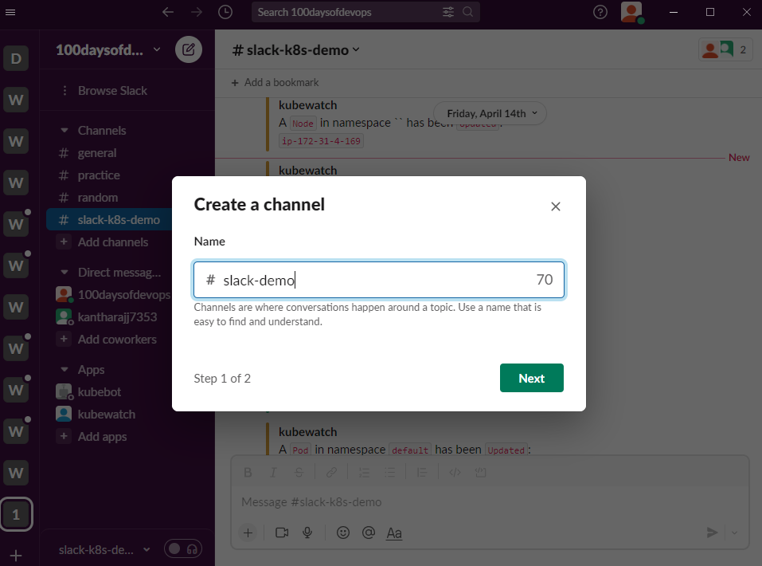

Slide 7
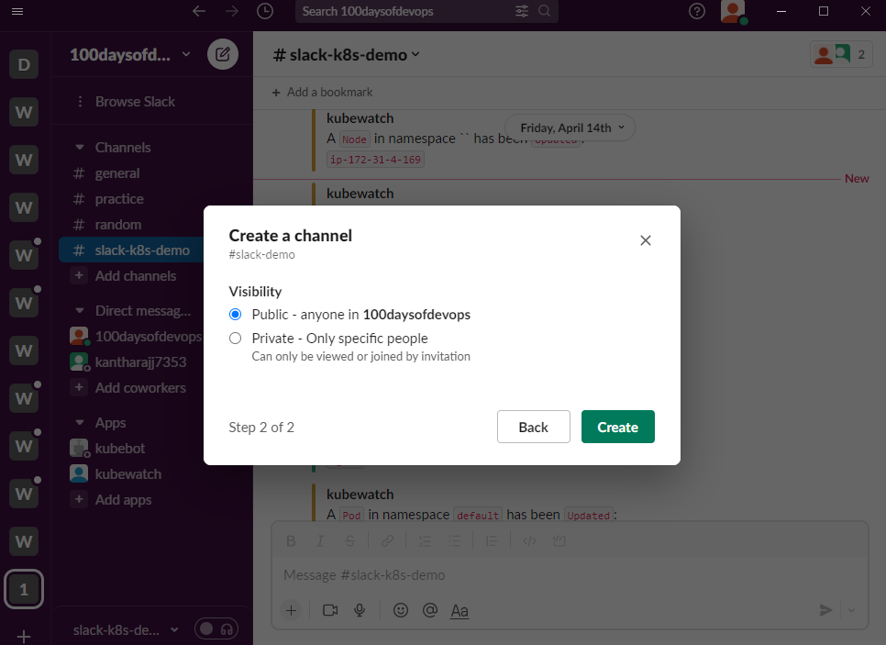

Slide 8
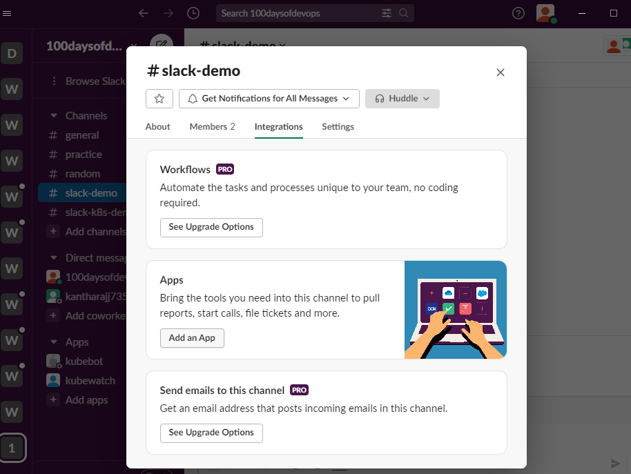

Slide 9
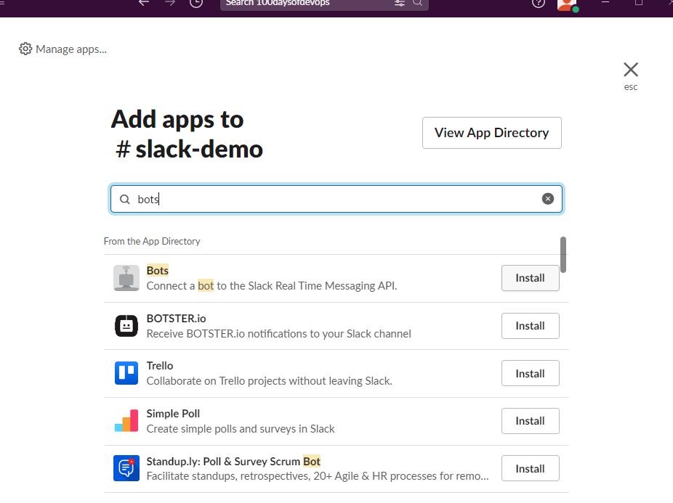

Slide 10
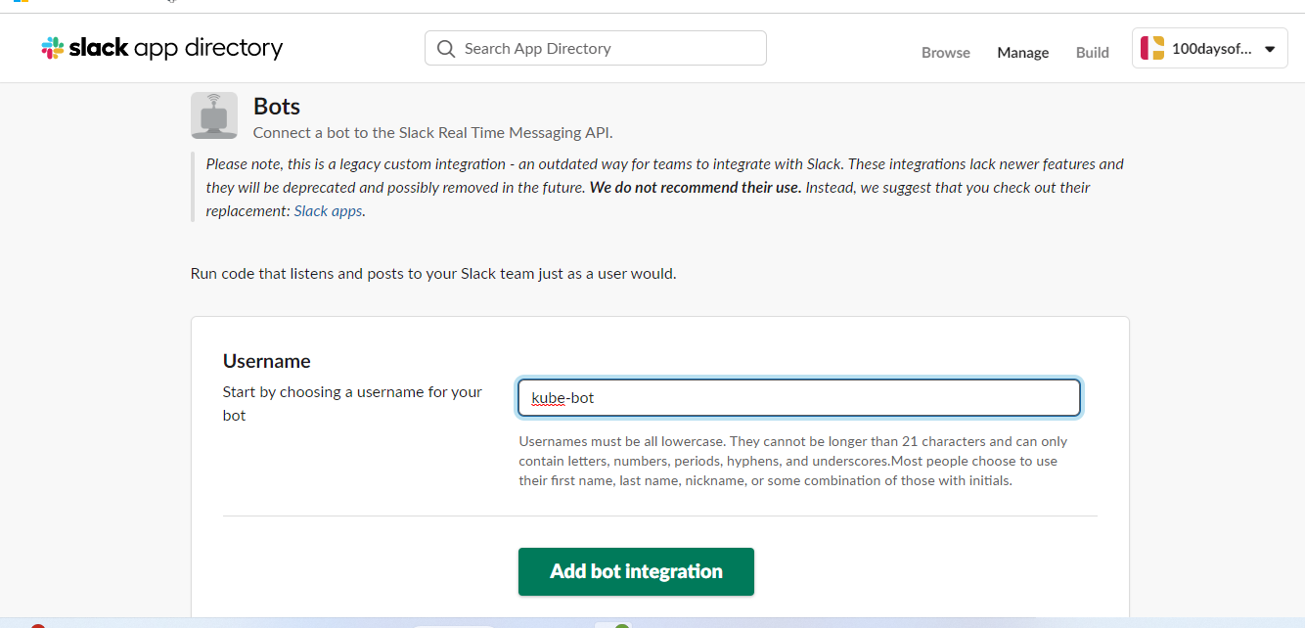

Slide 11
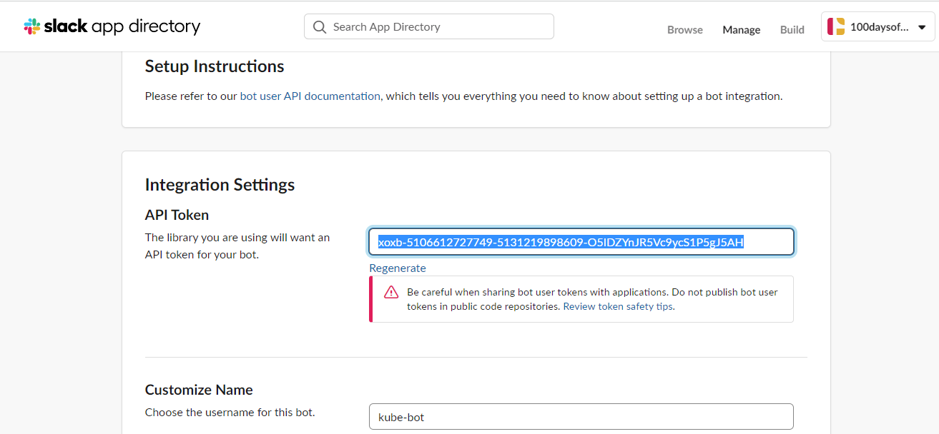

Slide 12
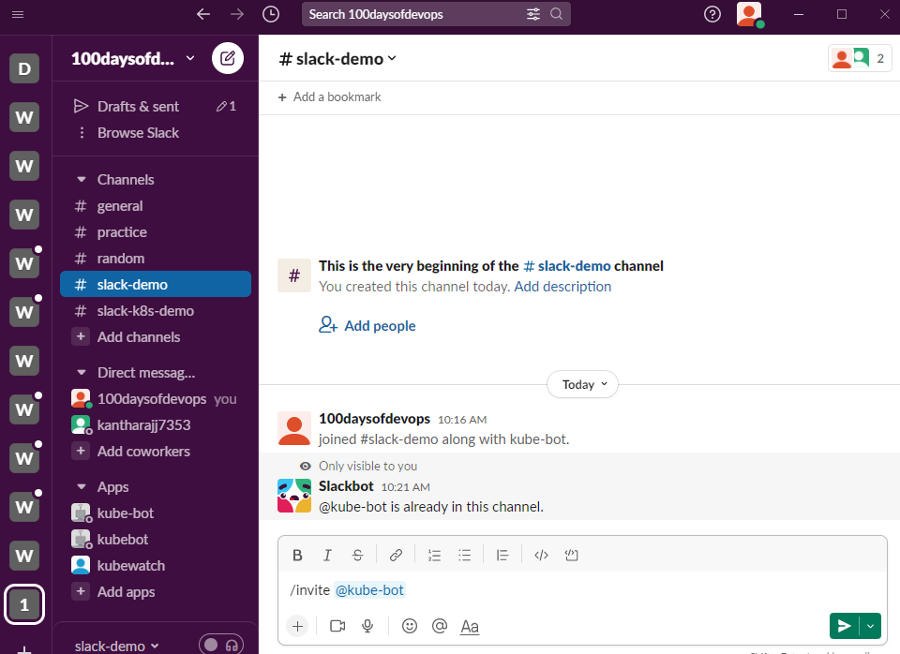

Slide 13
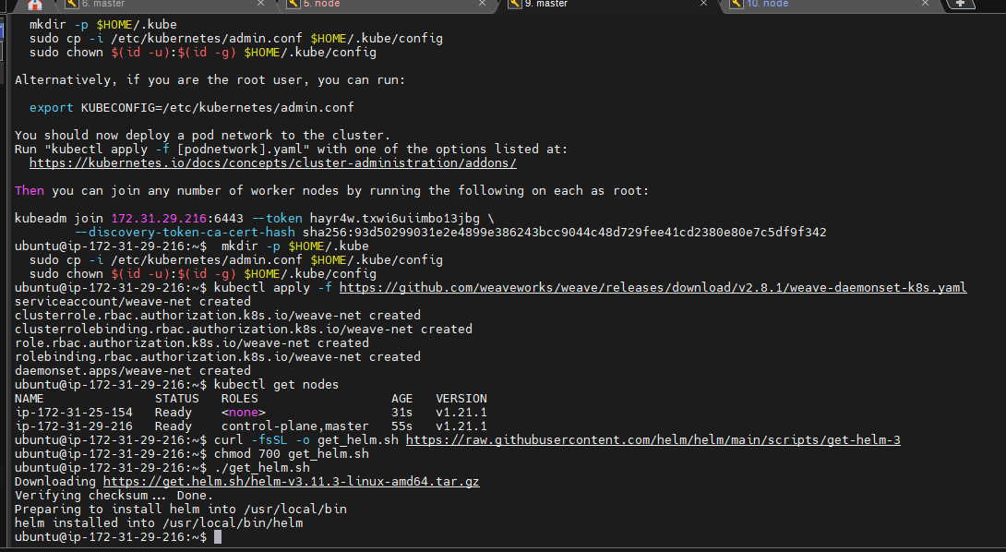

Slide 14


Slide 15
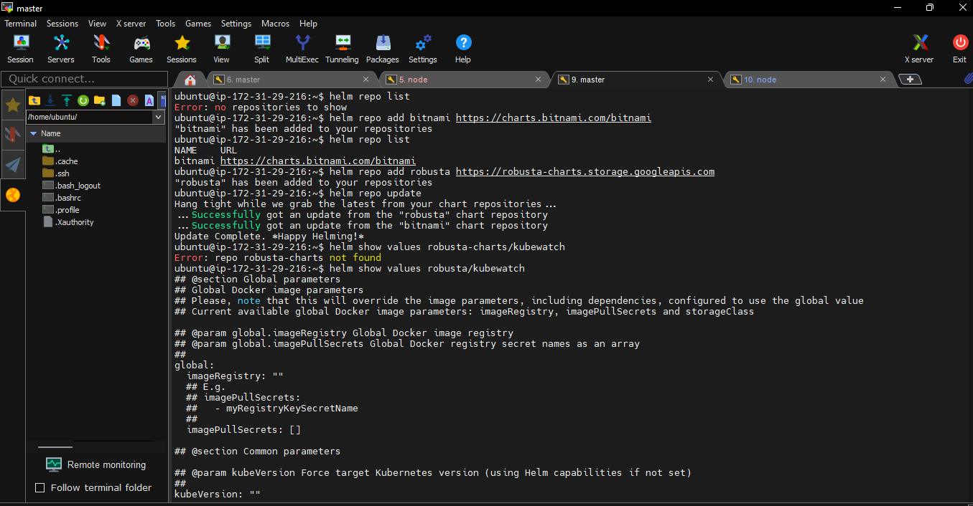

Slide 16
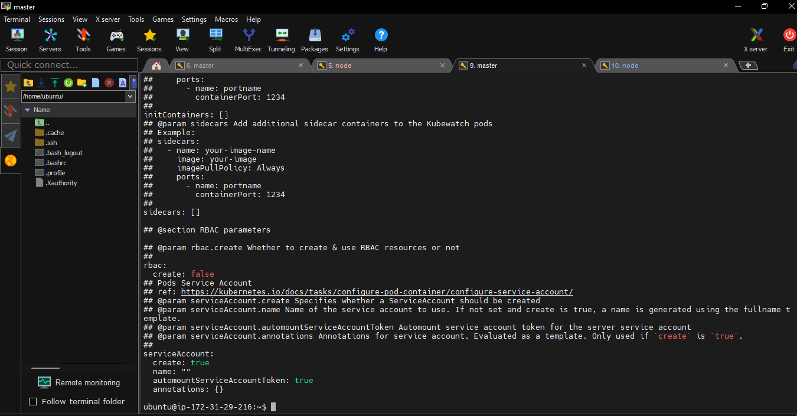

Slide 17
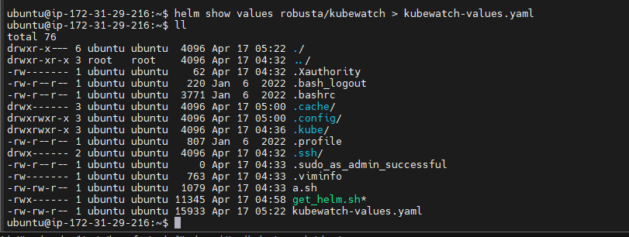

Slide 18
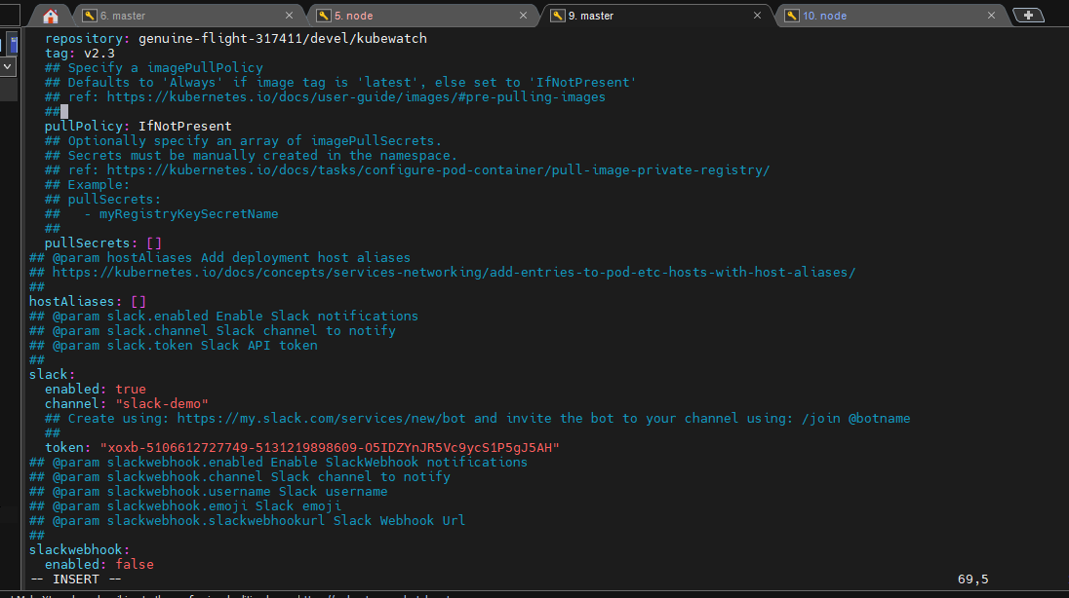

Slide 19
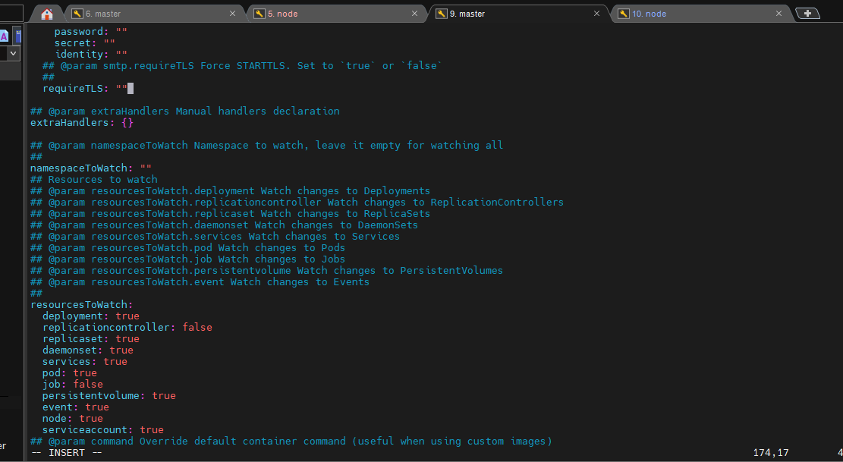

Slide 20
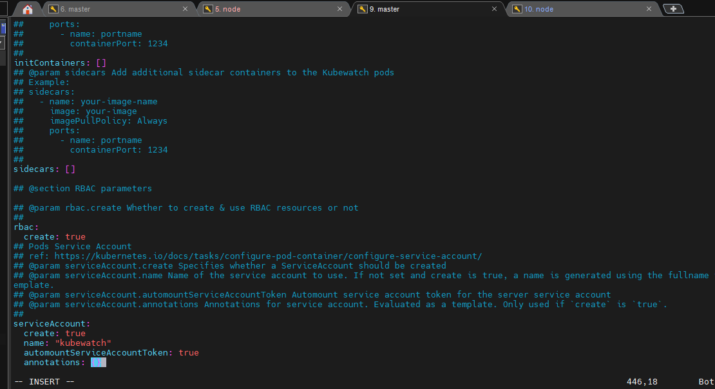

Slide 21
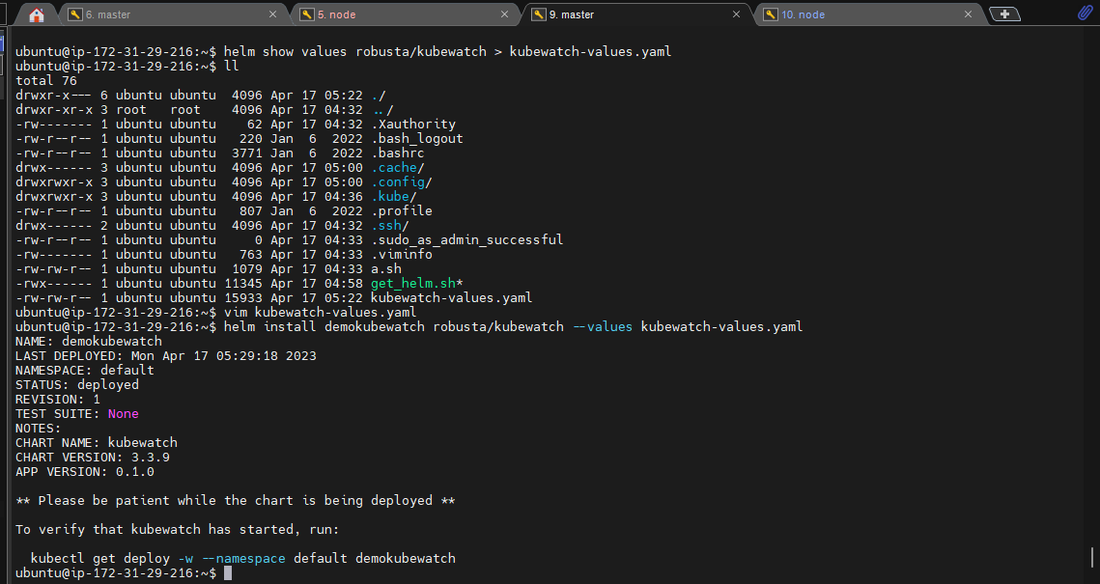

Slide 22
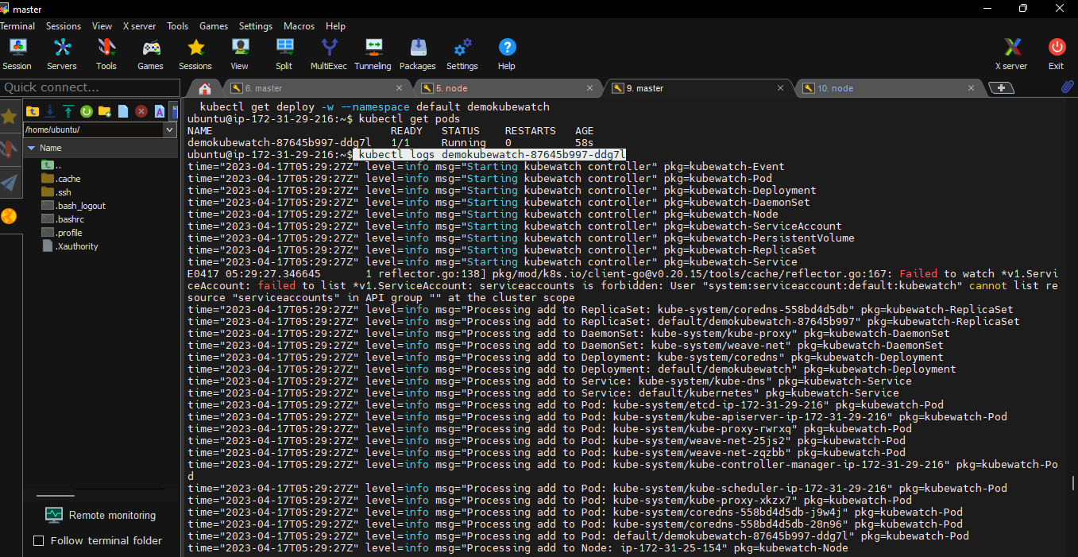

Slide 23
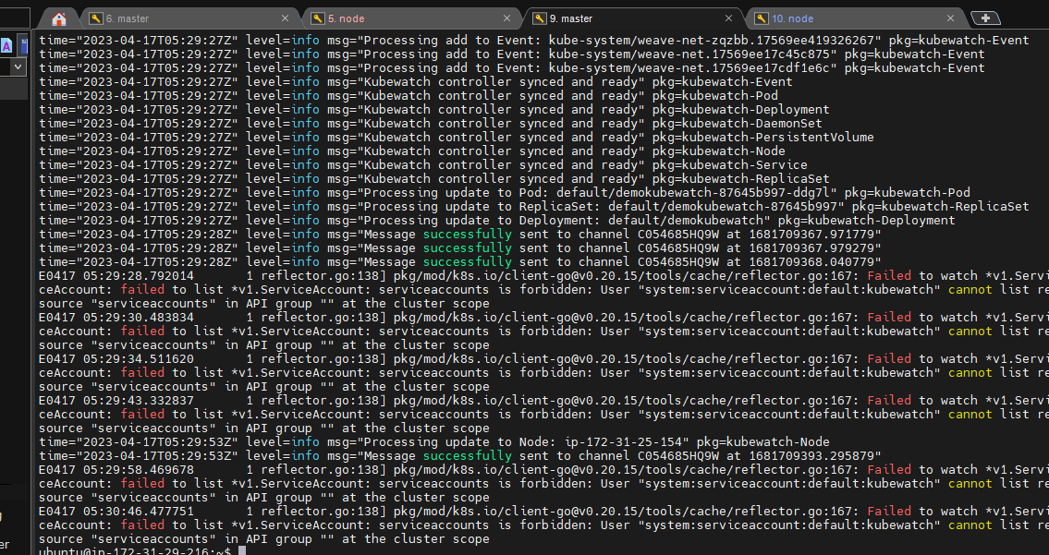

Slide 24
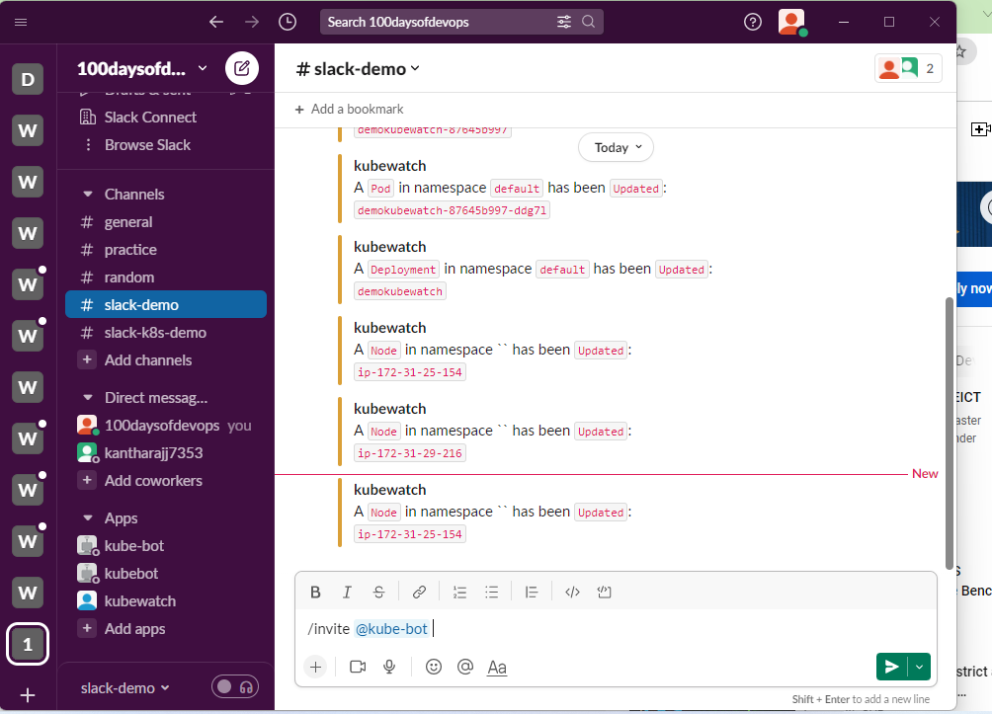

Slide 25
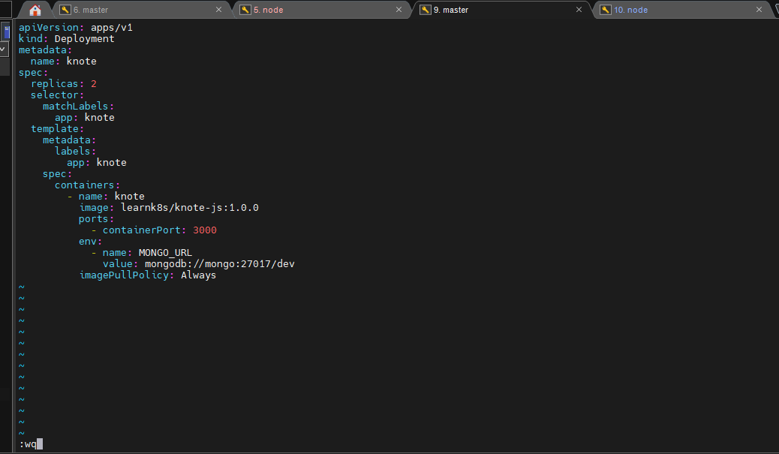

Slide 26
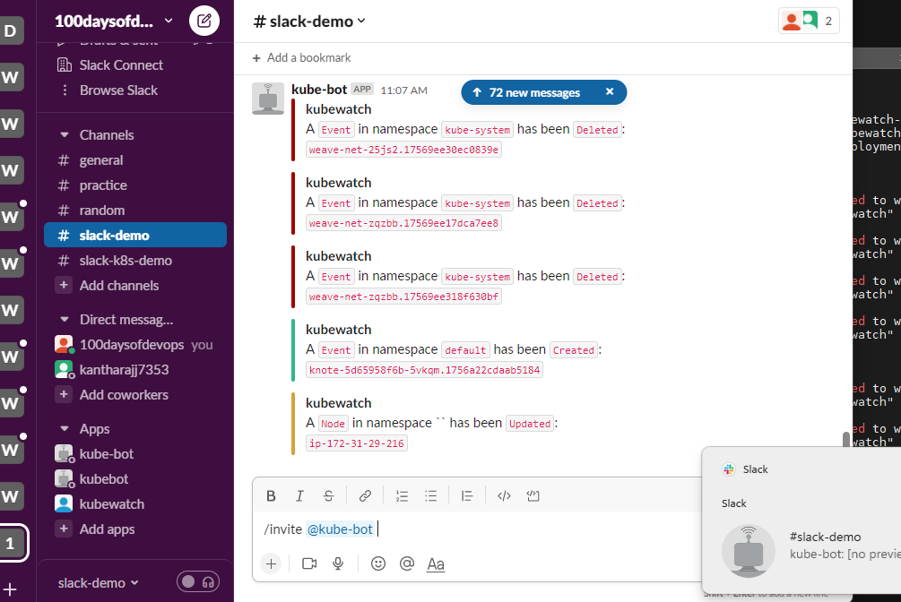

Slide 27
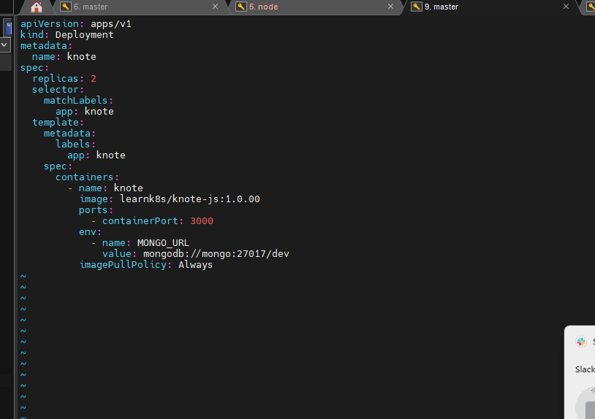

Slide 28
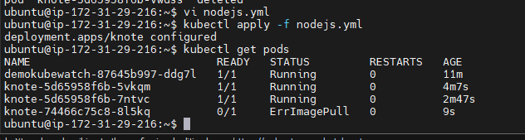

Slide 29
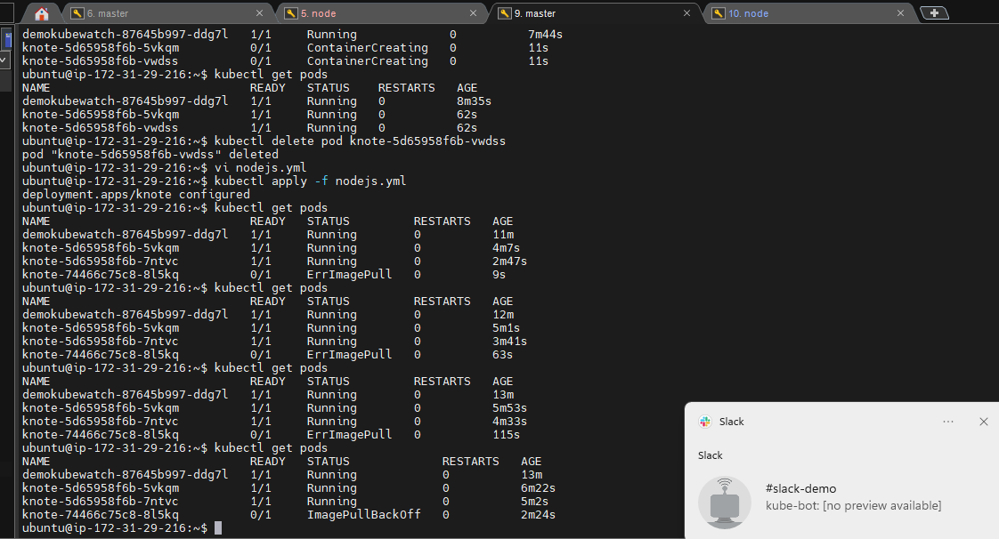

Slide 30
